Slide 1
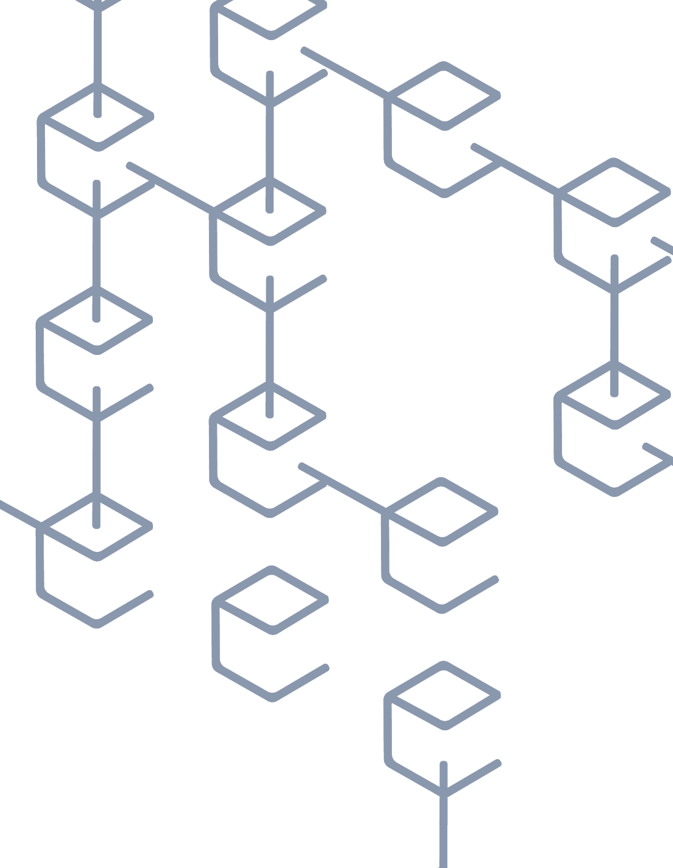
Blockchain Technology and The Opioid Crisis
By Leona Edegbe

Slide 2
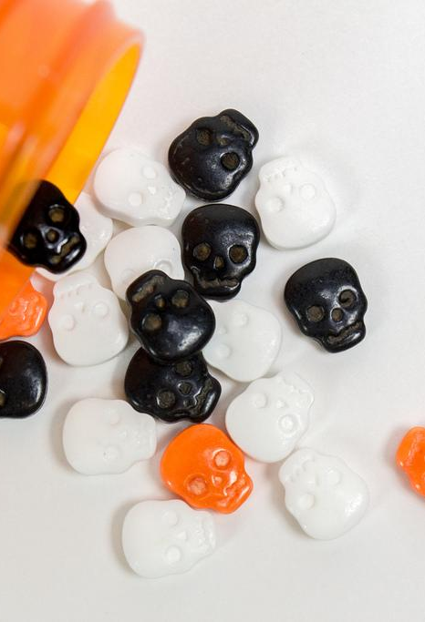
Introduction
What is the Opioid Crisis?
The Opioid crisis is a term used to refer to the rapid increase in the use of prescription and non prescription opioid drugs in the United States and Canada.
Notes:
Opiod are painkillers , They also activate the reward areas of the brain by releasing the hormone dopamine, creating a feeling of euphoria or a "high."
Since the 1990’s . Unfortunately for more than 20 years, more than 68% of the number of of the drug overdose deaths in the United States is caused by opioids alone in 2017.
The range of the drugs from moderately strong painkillers to very strong painkillers. This is affecting Americans below the age of 50.

Slide 3
Fact
Unfortunately, for more than 20 years, more than 68% of the number of the drug overdose deaths in the United States is caused by opioids alone in 2017.
Notes:
Since the 1990’s . Unfortunately for more than 20 years, more than 68% of the number of of the drug overdose deaths in the United States is caused by opioids alone in 2017.
The range of the drugs from moderately strong painkillers to very strong painkillers. This is affecting Americans below the age of 50.

Slide 4
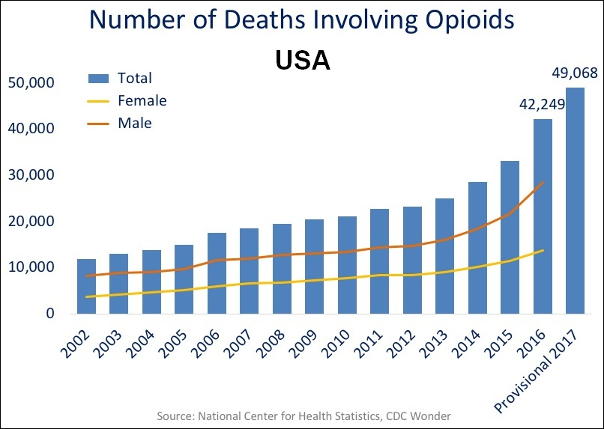
Numbers

Slide 5
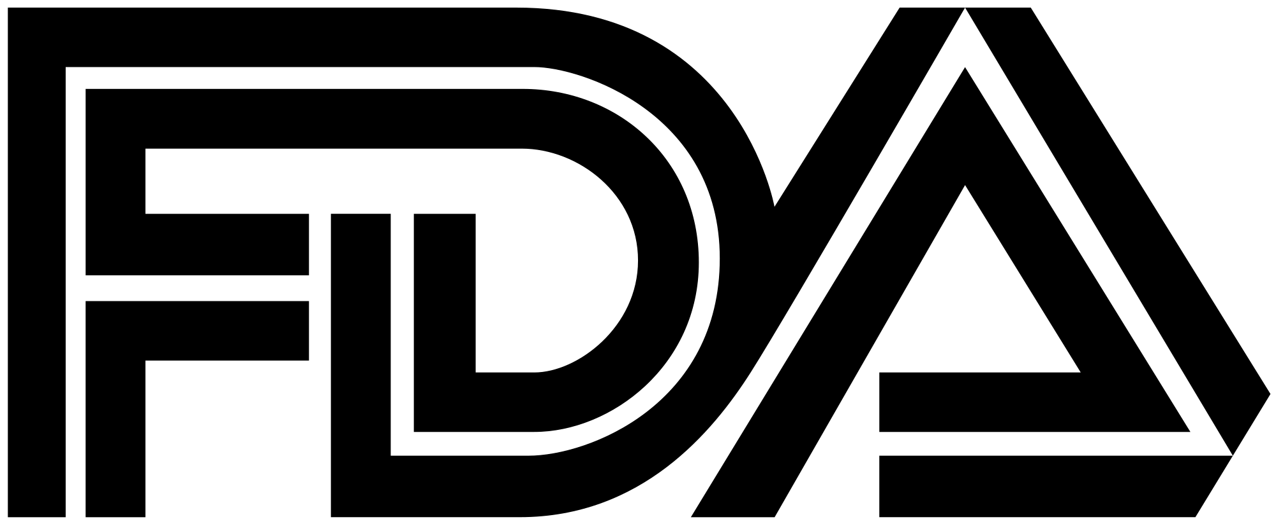


How is drug data collected?
The Prescription Monitoring program is a state-run program that collects and distributes data about the prescription and dispensation of federally controlled substances and, as the individual states deem appropriate, of addictive prescription drugs.

Slide 6
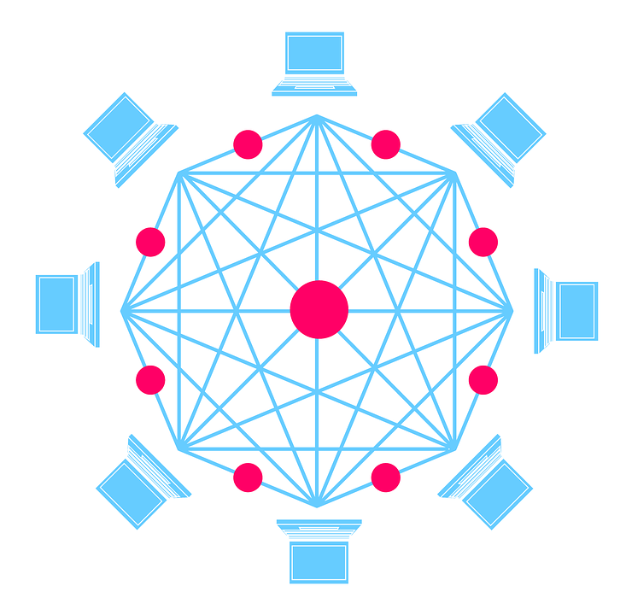
Why Blockchain?

Slide 7
What is Blockchain
A blockchain is an incorruptible digital ledger of economic transactions that can be programmed to record not only financial transactions but virtually everything of value.

Slide 8
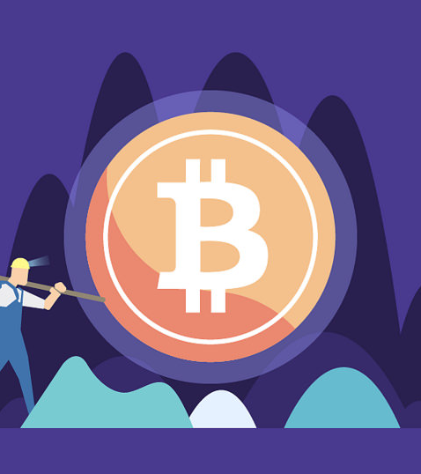
Various Definitions
Blockchain is an all-encompassing technology that is integrating across platforms and hardware all over the world. A blockchain is a data structure that makes it possible to create a digital ledger of data and share it among a network of independent parties.

Slide 9
Why called Blockchain?
If this technology is so complex, why call it “blockchain?” At its most basic level, blockchain is literally just a chain of blocks, but not in the traditional sense of those words. When we say the words “block” and “chain” in this context, we are actually talking about digital information (the “block”), stored in a public database (the “chain”).

Slide 10
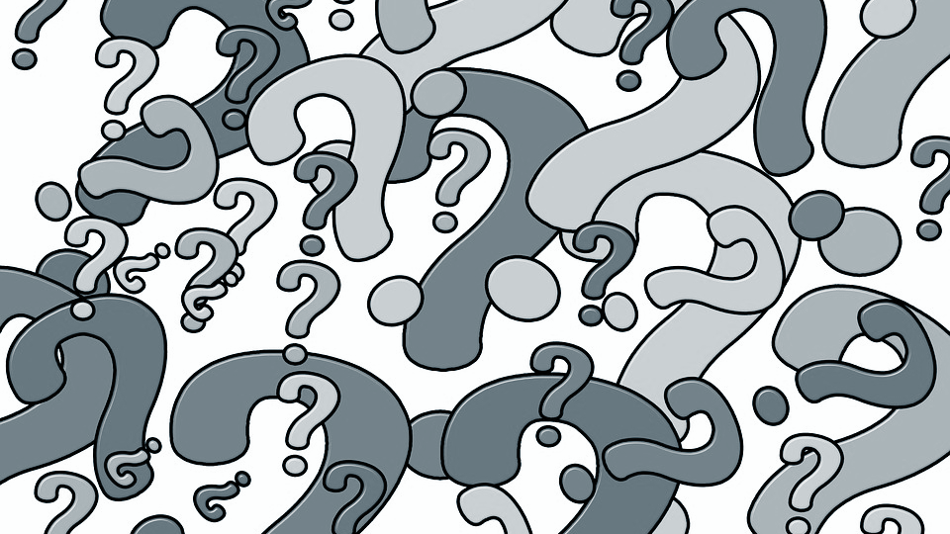
How does It work?

Slide 11
Think about this
What if you want to send a Microsoft Word document to another recipient, and ask them to make revisions to it. There could be a lot of problems when doing this due to the fact that you need to wait until receiving a return copy before you can see or make other changes because you are locked out of editing it until the other person is done with it.

Slide 12
Quite frustrating right?
Unfortunately that’s how databases work today.
T _ T

Slide 13
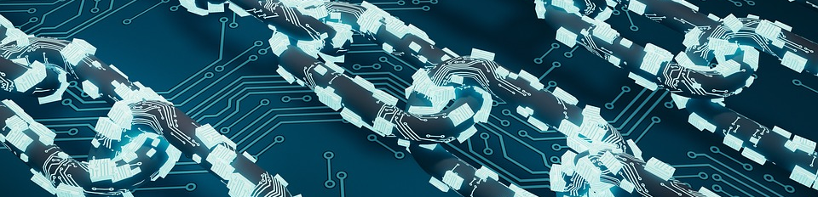
This is where Blockchain comes
With blockchain both parties have access to the same document at the same time, and the single version of that document is always visible to both of them. It is like a shared ledger, but it is a shared document. The distributed part comes into play when sharing involves a number of people.

Slide 14
It is quite a flexible tool
The technology has been used for the health records for patients and start up companies are making new headway with electronic medical records. So with the Opioid issue the blockchain technology can be explored.

Slide 15
The Properties of Blockchain
IMMUTABLE
DISTRIBUTED
CONSENSUS BASED
TRANSPARENT
Notes:
Immutable anything on the ledger is set in stone. New transaction can be added at the end, however the history will always be there. If the health practitioner over prescribes a opioid and try to change any detail to the ledger. It would be seen by all stakeholder
Ethereum, hyperledger- it is not maintained by a central database or device. No monotony of the database. It is a network of devices ethereum- miners or hyperledger peers
Consensus based- since a blockchain distributed which in otherwords managed by nodes. Each node must agree on the state of the ledger an the state of transaction at all times. They are all synchronised

Slide 16

WHAT IF
?????

Slide 17
Blockchain and Opioid Supply
Lets see how we can use the properties of the properties with the Opioid Crisis:
IMMUTABLE- Imagine all the stakeholders can have access to a distributed ledger smart contract to have access to the supply and prescription of Opioid. If the health practitioner tries to abuse the privilege of prescribing opioid.
DISTRIBUTED & CONSENSUS BASED: the output of the smart contract can be validated by everyone on the network.
TRANSPARENT:All stakeholders can view the transaction on this ledger.
Notes:
Immutable anything on the ledger is set in stone. New transaction can be added at the end, however the history will always be there. If the health practitioner over prescribes a opioid and try to change any detail to the ledger. It would be seen by all stakeholder
Ethereum, hyperledger- it is not maintained by a central database or device. No monotony of the database. It is a network of devices ethereum- miners or hyperledger peers
Consensus based- since a blockchain distributed which in otherwords managed by nodes. Each node must agree on the state of the ledger an the state of transaction at all times. They are all synchronised

Slide 18
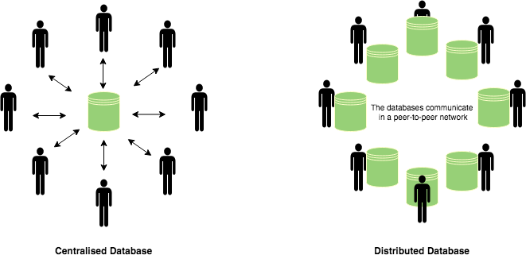
All stakeholders are on this peer to peer network. Each peer or node are considered equal.
Notes:
The method of transferring data is not held in a centralized point making it less hacked or even exploited.

Slide 19
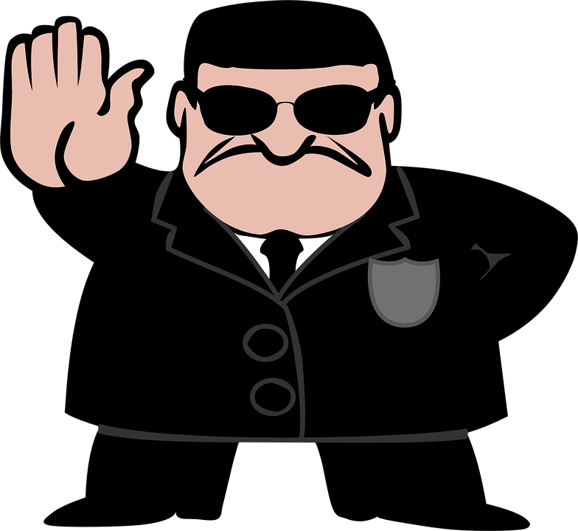
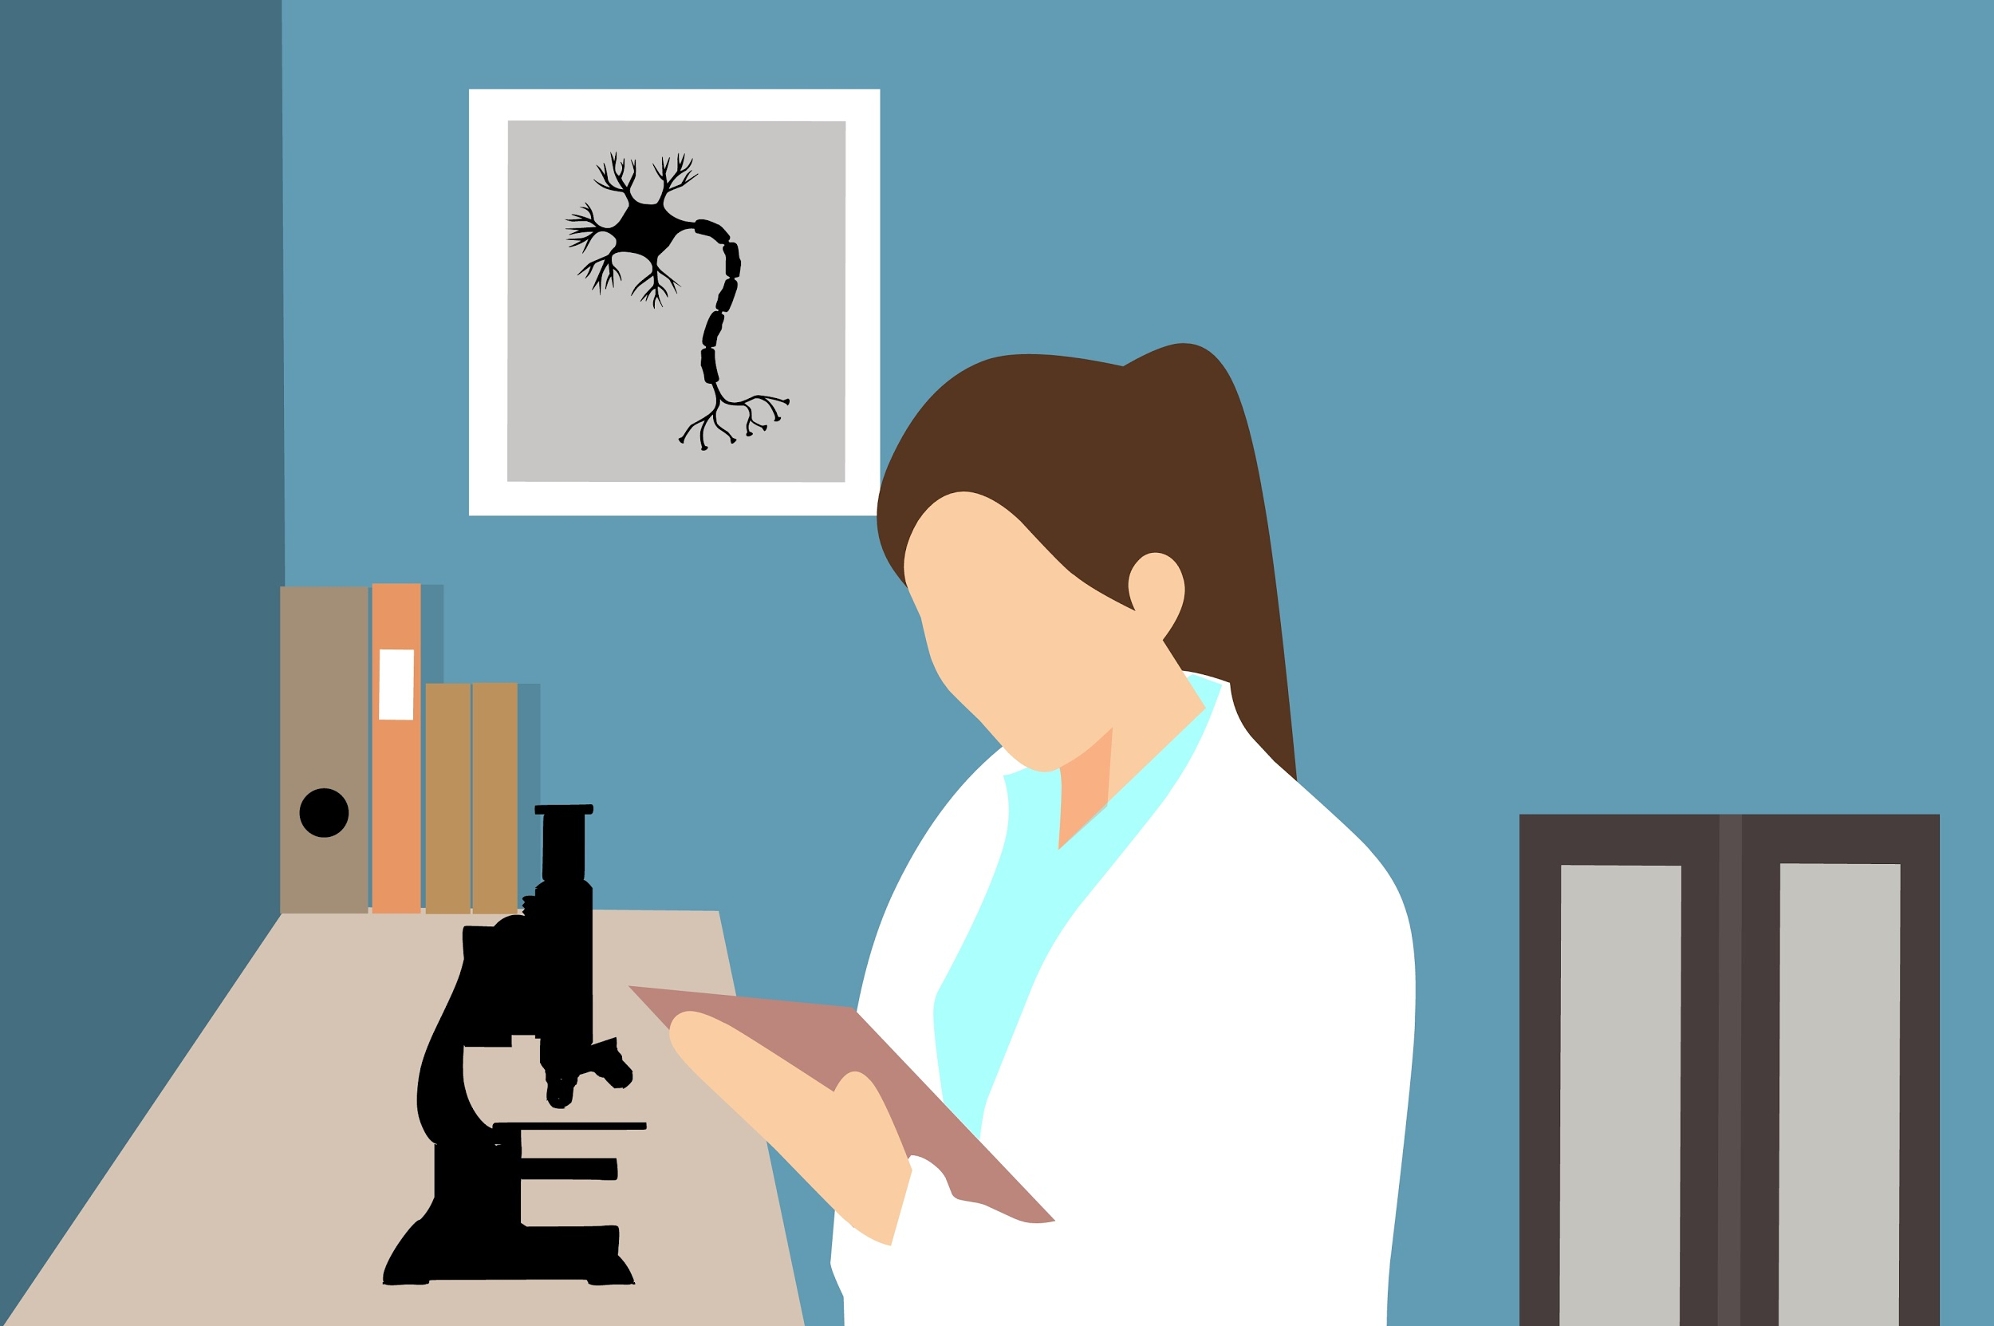
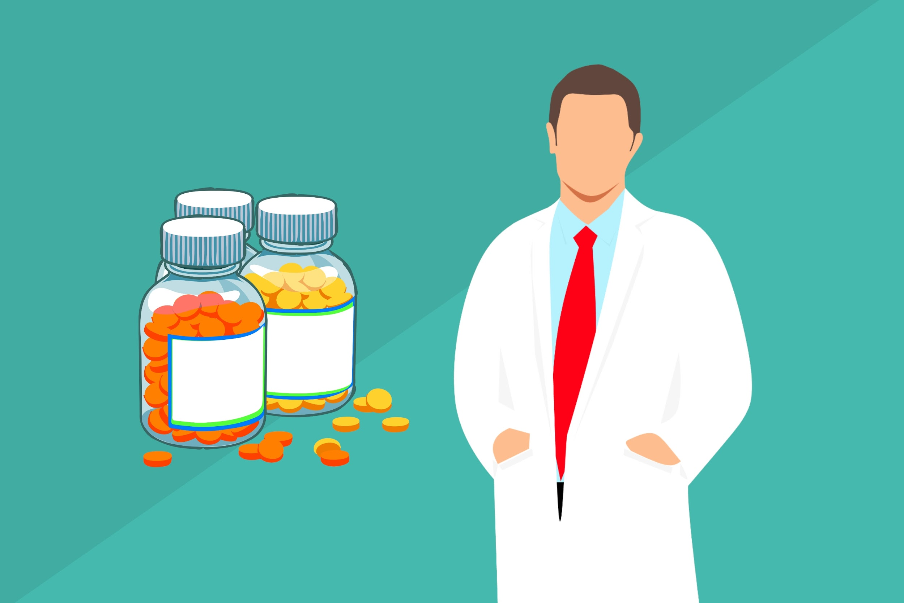


Blockchain and Opioid Supply
Notes:
Immutable anything on the ledger is set in stone. New transaction can be added at the end, however the history will always be there. If the health practitioner over prescribes a opioid and try to change any detail to the ledger. It would be seen by all stakeholder
Ethereum, hyperledger- it is not maintained by a central database or device. No monotony of the database. It is a network of devices ethereum- miners or hyperledger peers
Consensus based- since a blockchain distributed which in otherwords managed by nodes. Each node must agree on the state of the ledger an the state of transaction at all times. They are all synchronised

Slide 20
Blockchain and Opioid Supply
Notes:
Immutable anything on the ledger is set in stone. New transaction can be added at the end, however the history will always be there. If the health practitioner over prescribes a opioid and try to change any detail to the ledger. It would be seen by all stakeholder
Ethereum, hyperledger- it is not maintained by a central database or device. No monotony of the database. It is a network of devices ethereum- miners or hyperledger peers
Consensus based- since a blockchain distributed which in otherwords managed by nodes. Each node must agree on the state of the ledger an the state of transaction at all times. They are all synchronised

Slide 21
Conclusion
Blockchain is time saving.
Cost saving
More secured
Notes:
No central authrity veriification
No need for third party verification because all stake holders has a copy of the shared ledger
Since theres no centralized db its data is shared among all stake holders. Which is safe from abuse of prescription

